Slide 1
House price prediction model
Presented by
Shivaraj Chawan(1RV22CS185)
Shrinidhi I (1RV22CS193)
Suraj Chanaveeragoudra (1RV22CS211)

Slide 2
Introduction
Problem Statement: The aim of this project is to develop a robust machine learning model capable of accurately predicting house prices based on various features such as location, size and amenities. By doing so, we seek to address several key challenges in the real estate market:
Price Volatility: House prices fluctuate over time due to changes in market conditions, demand-supply dynamics, and economic factors the predictive models can help stakeholders anticipate these fluctuations and make informed decisions regarding buying, selling, or investing in properties.
Market Inefficiencies: In many real estate markets, there are inefficiencies caused by asymmetric information and subjective valuations. A data-driven approach can provide more objective and accurate pricing estimates, reducing the risk of overpaying or underselling properties.
Location Sensitivity: Location is a critical determinant of property value, but its impact can vary significantly depending on factors such as neighborhood amenities, proximity to schools and transportation, and crime rates.

Slide 3
Literature Survey
Sl No | Author and Paper title | Details of Publication | Summary of the Paper
1 | Udit Deo HOUSE PRICE PREDICTION USING REGRESSION TECHNIQUES | Research gate February 2021 DOI:10.13140/RG.2.2.27657.98408 | House price forecasting is an important topic of real estate. The literature attempts to derive useful knowledge from historical data of property markets. Machine learning techniques are applied to analyze historical property transactions in India to discover useful models for house buyers and sellers. Revealed is the high discrepancy between house prices in the most expensive and most affordable suburbs in the city of Mumbai. Moreover, experiments demonstrate that the Multiple Linear Regression that is based on mean squared error measurement is a competitive approach.
2 | Quang Truong Housing Price Prediction via Improved Machine Learning Techniques | Procedia Computer Science Volume 174, 2020, Pages 433-442 | House Price Index (HPI) is commonly used to estimate the changes in housing price. Since housing price is strongly correlated to other factors such as location, area, population, it requires other information apart from HPI to predict individual housing price. There has been a considerably large number of papers adopting traditional machine learning approaches to predict housing prices accurately, but they rarely concern about the performance of individual models and neglect the less popular yet complex models. As a result, to explore various impacts of features on prediction methods, this paper will apply both traditional and advanced machine learning approaches to investigate the difference among several advanced models.

Slide 4
Linear Regression
Linear Equation: Represented as Y=β₀​+β₁​X+ε, where Y is the dependent variable, X is the independent variable, β₀​ is the intercept, β₁​ is the slope, and ε is the error term.
Objective Function: Minimize the sum of squared differences between observed and predicted values: minimize ∑_{i=1}^{N}​(Yi​−(β0​+β1​Xi​))².
Parameter Estimation: Using methods like Ordinary Least Squares (OLS) to estimate coefficients β₀​ and β₁​ by optimizing the objective function.
Assumptions: Linearity, independence of errors, homoscedasticity, and normality of errors are key assumptions for a valid linear regression model.
Interpretation: Coefficients β₀​ and β₁​ quantify the intercept and slope, respectively, providing insight into the relationship between the variables.

Slide 5
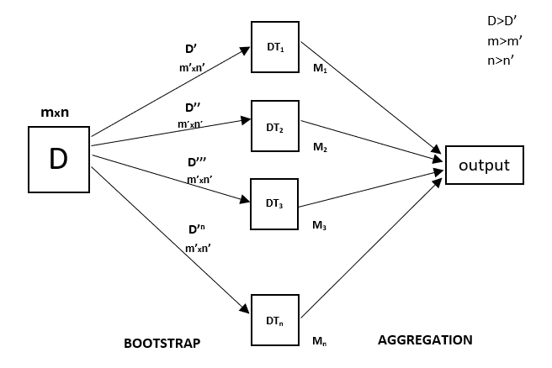
RandomForestRegressor
Ensemble Method: RandomForestRegressor combines multiple decision trees trained on random subsets of the data, averaging their predictions to improve robustness and accuracy.
Bootstrap Aggregating (Bagging): Each tree is trained on a bootstrapped sample of the data, ensuring diversity among the trees. At each split, a random subset of features is considered, reducing correlation between trees and enhancing generalization.
Prediction Aggregation: Predictions from individual trees are averaged (for regression) to produce the final ensemble prediction, mitigating overfitting.
Bias-Variance Tradeoff: By averaging predictions from multiple trees, RandomForestRegressor typically reduces variance compared to individual decision trees, balancing variance for better performance.

Slide 6
Ridge Regressor
Objective Function: Ridge regression minimizes the sum of squared errors plus a penalty term proportional to the squared magnitudes of the coefficients: minimize(∑_{i=1}^{n}​(yi​−y^​i​)²+λ∑_{j=1}^{p}​β_{j}²​).
Regularization Parameter: The parameter λ controls the amount of regularization applied, balancing between fitting the training data and preventing overfitting:λ>0.
Coefficient Shrinkage: Ridge regression shrinks the coefficient estimates towards zero, proportionally to the penalty term, effectively reducing the impact of high-variance predictors: βridge​=(X^{T}X+λI)⁻¹X^{T}y.
Matrix Algebra Solution: The closed-form solution involves matrix inversion, where X represents the design matrix of predictors, y is the target vector, and I is the identity matrix.
Bias-Variance Tradeoff: By penalizing large coefficients, Ridge regression increases bias but reduces variance, offering improved generalization performance, especially in the presence of multicollinearity.

Slide 7
XGB Regressor
Objective Function: XGBRegressor minimizes a regularized objective function, which combines the sum of individual loss functions L with a regularization term R to control model complexity: Obj=∑_{i=1}^{n​}L(y_{i}​,y^​_{i}​)+∑_{k=1}^{K}​Ω(f_{k}​)
Loss Function: The loss function L measures the difference between predicted y^_{​i​} and actual y_{i​} values, such as squared error loss or absolute error loss: L(y_{i}​,y^​_{i}​).
Regularization Term: The regularization term R penalizes the complexity of the model, where Ω(f_{k}​) represents the complexity of each individual tree f_{k}​ in the ensemble.
Gradient Boosting Update Rule: XGBRegressor updates the model by iteratively fitting new trees to the negative gradients of the loss function, using gradient descent-like optimization: f_{k}​=f_{k−1}​−η⋅∇Obj
Tree Structure: Each tree fk​ is defined by a set of decision rules based on input features, determining the predicted value for each sample by traversing the tree from root to leaf.

Slide 8
Other models
Gradient Boosting Regressor: Combines weak learners (usually decision trees) sequentially, minimizing the residual errors of the previous models using gradients of the loss function.
Support Vector Regressor (SVR): Finds the hyperplane that maximizes the margin between data points and the regression line, subject to a tolerance margin ϵ, aiming to minimize the loss and achieve a good tradeoff between simplicity and accuracy.
Decision Tree Regressor:Decision tree regression recursively partitions the feature space into disjoint regions by selecting split points that minimize the sum of squared errors within each partition.

Slide 9
Usage of Maths in models
Linear Algebra:
System of Equations:
Support Vector Regression (SVR) and other regression models can be viewed as solving a system of linear equations to find the optimal coefficients.
The objective is to find the solution that minimizes the error between predicted and actual values, often formulated as solving a system of linear equations.
Eigenvalues and Eigenvectors:
Eigenvalues and eigenvectors are fundamental concepts in linear algebra used in various machine learning algorithms, such as PCA (Principal Component Analysis).For example, in dimensionality reduction techniques like PCA, eigenvalues and eigenvectors are computed to find the principal components of the data.

Slide 10
Usage of Maths in models
Linear Algebra:
Matrix Operations:
All models involve matrix operations for efficient computation, such as dot products, matrix-vector multiplication, and matrix-matrix multiplication.
Matrix decomposition techniques like Singular Value Decomposition (SVD) and QR decomposition are used in various machine learning algorithms for feature extraction, regularization, and model interpretation. For instance, in XGBoost, matrix decomposition may be used internally to optimize the objective function and perform feature selection
Vectorization:
Machine learning algorithms often benefit from vectorized computations to speed up calculations, utilizing libraries optimized for linear algebra operations.
Vectorization helps in performing computations on large datasets efficiently, improving the training and prediction speed of models.

Slide 11
Usage of Maths in models
Statistical concepts:
Probability Distributions:
Probability distributions are fundamental in understanding the assumptions and behavior of machine learning models.
For instance, in SVR, the choice of kernel function (e.g., linear, polynomial, Gaussian) defines the implicit probability distribution over the input space.
Regression Analysis:
All the mentioned models are regression techniques, aiming to predict continuous target variables based on input features.
They rely on statistical regression analysis principles to estimate the relationship between predictors and the target variable..
Residual Analysis:
Residual analysis is crucial for assessing the goodness-of-fit of regression models and identifying patterns in model errors.
Residuals are often examined to check for violations of model assumptions, such as homoscedasticity and normality of errors.

Slide 12
Usage of Maths in models
Statistical concepts:
Model Evaluation Metrics:
Statistical metrics such as Mean Squared Error (MSE), Root Mean Squared Error (RMSE), Mean Absolute Error (MAE), and R² are commonly used to evaluate the performance of regression models.
These metrics provide quantitative measures of how well the model predictions align with the actual target values.
Statistical Inference:
Statistical inference techniques are used to draw conclusions about the population based on sample data.
For example, confidence intervals may be computed to quantify the uncertainty in model predictions or parameter estimates.

Slide 13
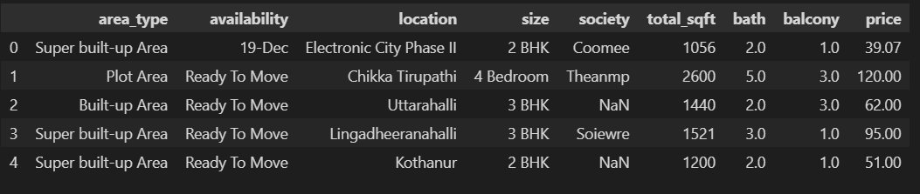
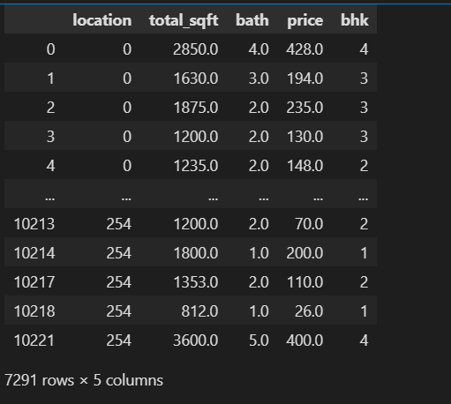
Data Set
Original Data
Cleaned data for model fitting

Slide 14
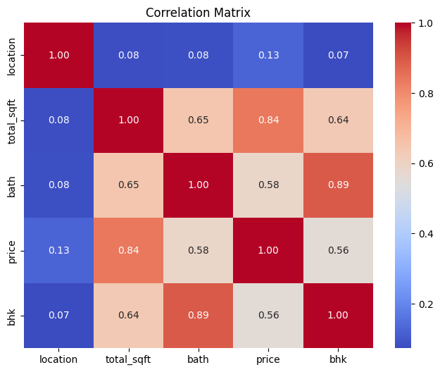
Data output analysis
Correlation matrix
A tabular representation showing the correlation coefficients between variables.
It quantifies the strength and direction of linear relationships between pairs of variables.
Provides a concise summary of how variables are related within a dataset.
It helps in understanding the degree to which variables move together or in opposite directions.
Facilitates the identification of patterns and dependencies among variables.
High correlation values indicate strong relationships, while low or negative values suggest weaker or inverse relationships.
Widely used across disciplines like finance, economics, and social sciences for data analysis and decision-making.
It assists in making informed decisions based on understanding the interrelationships within complex datasets

Slide 15
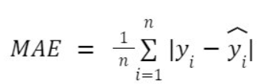
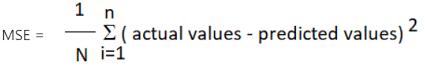
Data output Analysis
Mean Absolute Error (MAE): It is the average of the absolute differences between predicted and actual values. It gives an idea of how wrong the model's predictions are on average.
Mean Square Error (MSE): It is the average of the squares of the differences between predicted and actual values. It gives more weight to large errors and less weight to small errors compared to MAE.

Slide 16
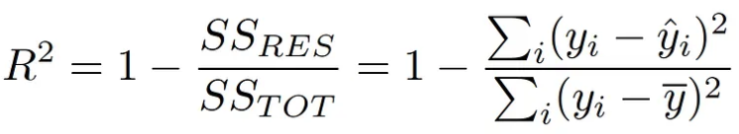
Data output Analysis
Root Mean Square Error (RMSE): It is the square root of the MSE. It is commonly used because it gives an error value in the same unit as the target variable, making it easier to interpret.
RMSE = √(MSE)
coefficient of determination, R²:measures the proportion of the variance in the dependent variable that is predictable from the independent variables. R squared score is a statistical measure that shows how well a regression model predicts the outcome of observed data.
R² ranges from 0-1.

Slide 17
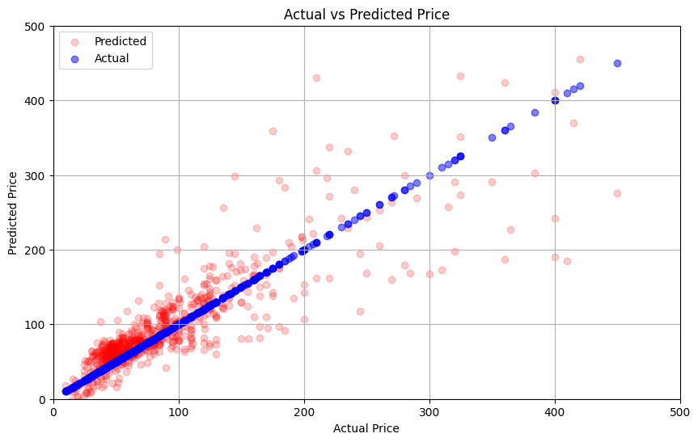

Data output Analysis
Model prediction plot of actual V/S Predicted price:
Linear Regression model
Train score: 0.7043, Test score: 0.7176
Mean Squared Error (MSE): 2517.178283290974
R-squared (R2): 0.7176487340907685
Mean Absolute Error (MAE): 23.903524685721163
XGB Regressor model
Train score: 0.9678, Test score: 0.9201
Mean Squared Error (MSE): 711.9415857080902
R-squared (R2): 0.9201416882894392
Mean Absolute Error (MAE): 14.14920066969362

Slide 18

Conclusion
The House Price Prediction Regression Model represents a pioneering effort in understanding Bangalore's real estate dynamics. By leveraging data and exploring various factors, including location, size, and amenities, the model offers valuable insights into the complexities of property valuation in this dynamic city. Its innovative approach not only provides a glimpse into the intricacies of Bangalore's housing market but also lays the foundation for more informed decision-making for buyers, sellers, and investors alike.

Slide 19
THANK YOU

